Slide 1
/ENTERPRISE/

Slide 2
A business firm/enterprise is an economic unit engaged in the production of one or more goods or services. A business firm buys economic resources (inputs) and sells the goods and services (outputs).

Slide 3
Enterprise is all about turning ideas into reality.

Slide 4
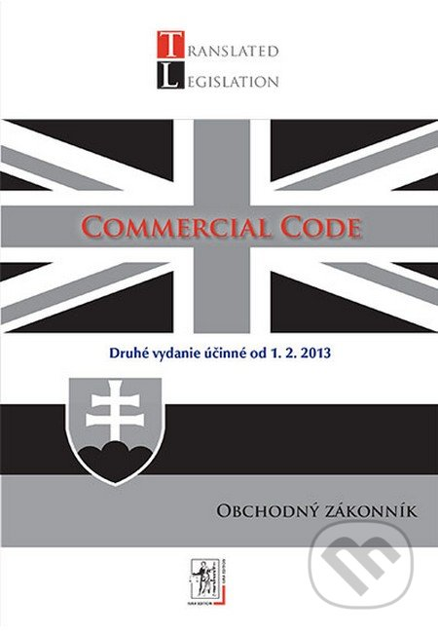
Definition by SLOVAK COMMERCIAL CODE
Term ” enterprise„ shall mean the whole of tangible, intangible and personnel assets.
Examples:
Tangible ___________________
Intangigle__________________
Personnel__________________

Slide 5
Basic features of enterprise: 1. Economic independence 2. Legal subjectivity

Slide 6
The economic independence of an enterprise is freedom in business and full responsibility for economic results.
Enterprise makes decisions, such as:
what goods to produce,
how are goods produced
what prices to charge
number of employees
how to promote

Slide 7
Legal subjectivity- the right of the company to act on its own behalf, to take on commitments and to take responsibility for their fulfillment.
Companies are also expected to act ethically and honestly with the community, their employees and shareholders.

Slide 8
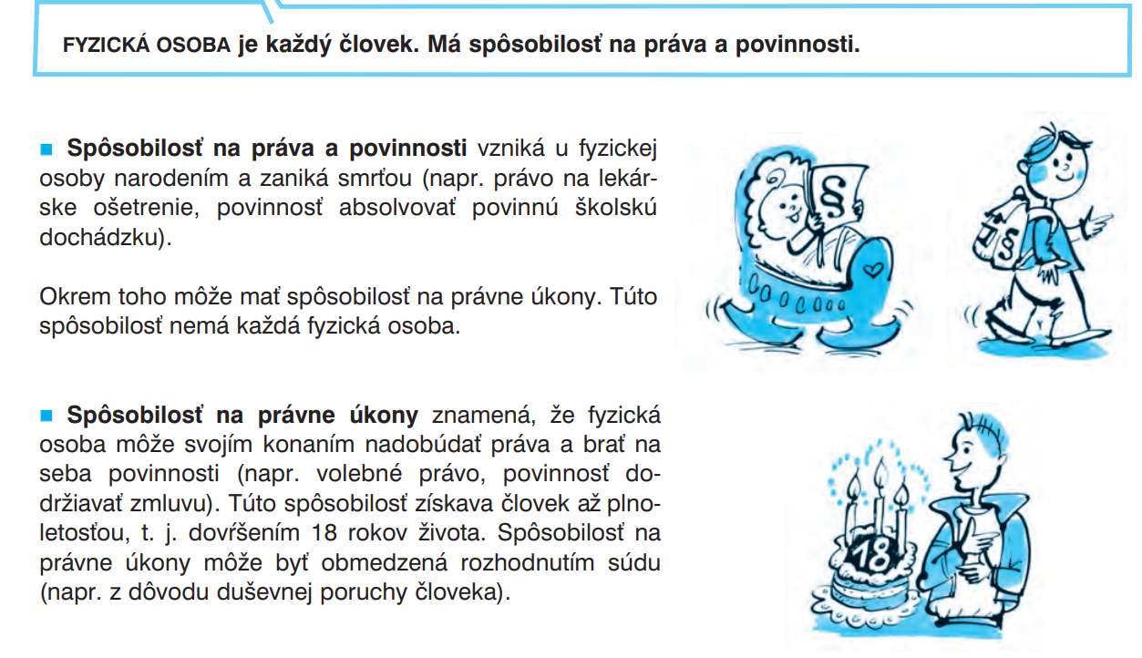
Natural Person /fyzická osoba/ is a human being and is a real and living person.

Slide 9
Legal person/legal entity/právnická osoba/ is an entity created by law and given certain legal rights and duties. For example, corporation, company etc.

Slide 10
Under the Slovak Commercial code entrepreneur can be:
a party registered in the Companies Register,
a party conducting business with a Trading License,
a party conducting business with an authorization other than Trading License
an individual engaged in agriculture, who is entered in a register according to special legislation.

Slide 11
Business name (Obchodné meno)
The term ” business name„ shall mean the name, under which the entrepreneur takes actions at law at the conduct of its business.

Slide 12
Business name
Natural person /sole proprietor (Fyzická osoba) | Legal entity (právnická osoba)
person's first name and surname person's first name and surname + the type of his business activity | the name under which such entity is recorded in the Companies Register + legal form
The of an) is the. The commercial name of an individual may be supplemented to identify the person of the entrepreneur or the type of his business activity.

Slide 13
COMPANIES/BUSINESS REGISTER
The “Companies Register" (Obchodný register) is a public list with legally required data of entrepreneurs and companies:
a) Business name and registered seat
b) IČO (organization identification number)
c) the subject of business
d) the legal form of a legal entity
e) the name and address of the persons who are the statutory authorities

Slide 14
Most common legal forms of Slovak Companies:
1. Legal entities
Limited Liability Company LLC– S.R.O. (spoločnosť s ručením obmedzeným)
Joint Stock Company JS– A.S. (akciová spoločnosť)
Limited Partnership LP– K.S (komanditná spoločnosť)
General Partnership GP– V.O.S. (verejná obchodná spoločnosť)

Slide 15
The main regulation of business law in Slovakia is the Commercial Code Act. No 513/1991
All legal entities must be registered in the Slovak Companies Register.
2. Sole Proprietorship – (fyzická osoba podnikateľského charakteru/ živnostník) is a type of business managed and owned by a single investor .
It´s not compulsory to be registered in the Slovak Companies Register.

Slide 16
Formation and Incorporation of an enterprise Založenie a vznik podniku
As a matter of Slovak law, the setting up of a company is divided into two stages:
Formation/establishment / - založenie;
Incorporation - vznik

Slide 17
Formation - založenie
Business plan - is a written description of your business's future, a document that tells what you plan to do and how you plan to do it.

Slide 18
Founders should be considering these factors when creating their plan.
Description of the company /business name, registered seat,../
Subject of Business
Main objectives
Mission statement
Market analysis
- Competitor analysis
- Characteristics of customers
Marketing plans
Management
Organizational structure
Financial needs

Slide 19
a company is founded on the basis of a Foundation agreement / Memorandum of association (spoločenská zmluva), signed by all of the founders.

Slide 20
2. Incorporation /vznik/
Legal entity - a company shall be incorporated on the date of their registration in the Business Register
Sole Proprietorship - trade licence announcement

