Slide 1
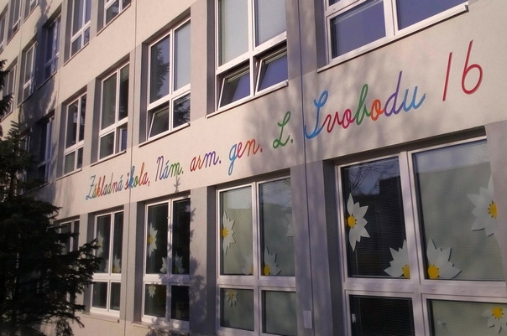
MY School
Zoe marcinová

Slide 2
This is A scHool swimming pool

Slide 3
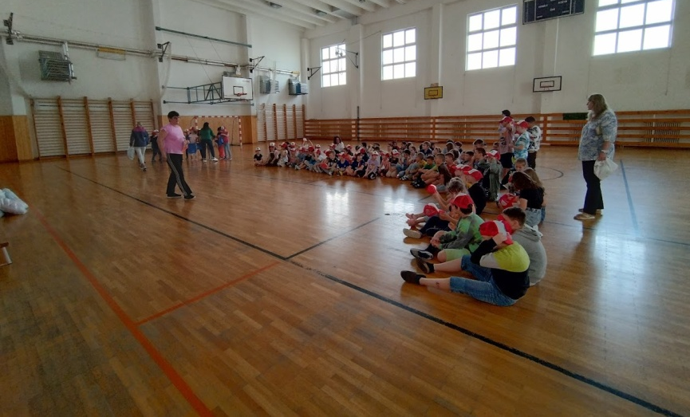
This si a School gym

Slide 4
These are the teachers
Jitka Feciľaková, Mária Kiovská, Viera Mikulová – English
Alena Fellegová, Mária Piskurová, Zuzana Arendáčová - PE
Petra Peláková - History Tatiana Bartošová - SJaL
Zuzana Petrová- Biology Dana Fellegiová- Maths
Marek Pataky – ICT Jana Harčárová – Geography
Mária Kiovská – Music Stanislav Polák – Art and Design

Slide 5
My schedule
 | 0 | 1 | 2 | 3 | 4 | 5 | 6
Monday | Swimming | Maths | Geography | English | SJaL | Music | PE
Tuesday | - | Biology | Art&design | Art&design | Maths | SJaL
Wednesday | - | Technical | SJaL | English | Maths | Swimming
Thursday | - | Biology | SJaL | History | Swimming | Maths
Friday | - | ICT | English | SJaL | Geography | Maths

Slide 6
my class teacher she is a great, all students like her.

Slide 7
Thank you for watching

