Slide 1
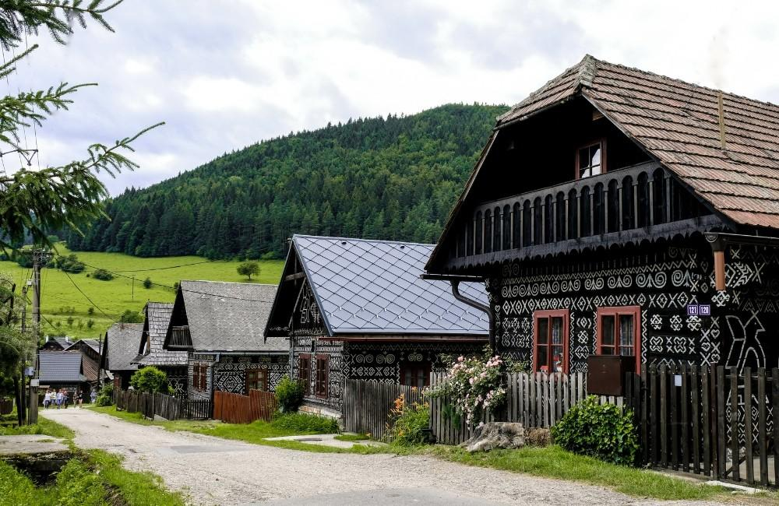
SLOVAK HOLIDAYS

Slide 2
SLOVAK HOLIDAYS
INTERNATIONAL: Christmas
Easter
Valentine
Mothers day
NATIONAL: Day of the etablishment of the SR
Day of the constitution of the SR
Feast of Saints Cyril and Methodius
All Saints’ Day

Slide 3
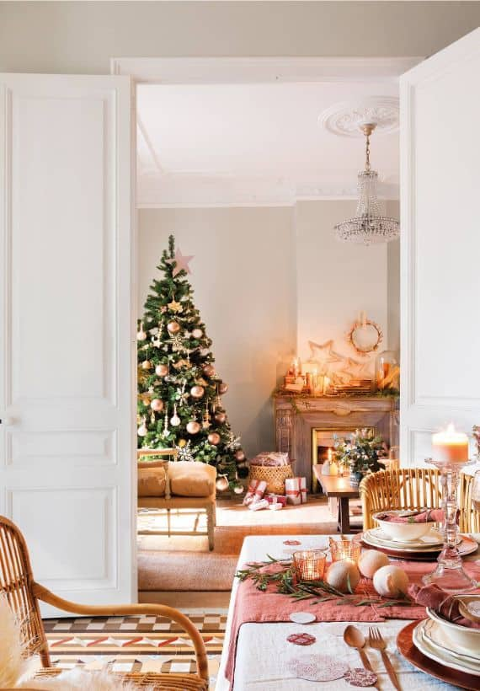
CHRISTMAS
December 24th
Celebrating the birth of Jesus Christ
We start by a dinner: fish and potato salad then we give each other presents
Our traditions are e.g. putting money and bread under the tablecloth or cross drew with honey

Slide 4
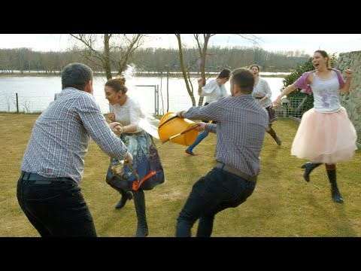
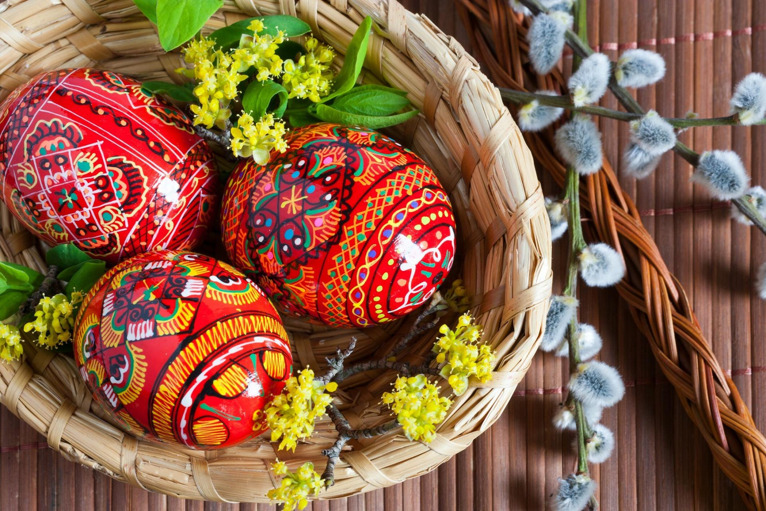
EASTER
Celebrating the resurrection of Jesus Christ
Our traditions : Men visit women and splash them with water or whip them gently with korbace, then men recieve money or chocolate, it is called sibacka
In slovak we also decorate eggs by painting them

Slide 5


Mother’s day:
May 12th
Celebration honoring mothers, motherhood
Valentine’s day:
February 14th
Celebrating love, boyfriends usually give presents to their girlfriends, e.g. roses, chocolate

Slide 6
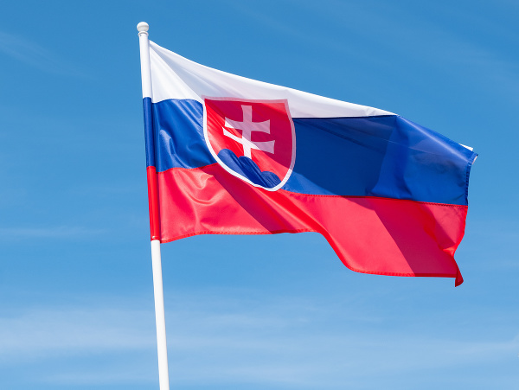
Day of the establishment of the Slovak Republic:
1st of January
Slovakia established on January 1st of 1993
we are staying home on this day
Day of the constitution of the SR:
September 1st
it memoralizes the adoption of the Slovak constitution in 1992
Feast of Saints Cyril and Methodius:
5th of July in Slovakia
Christian feast in honor of the brothers for coming to Slovakia and Czech republic

