Slide 1
Welcome to our town
Hlohovec

Slide 2
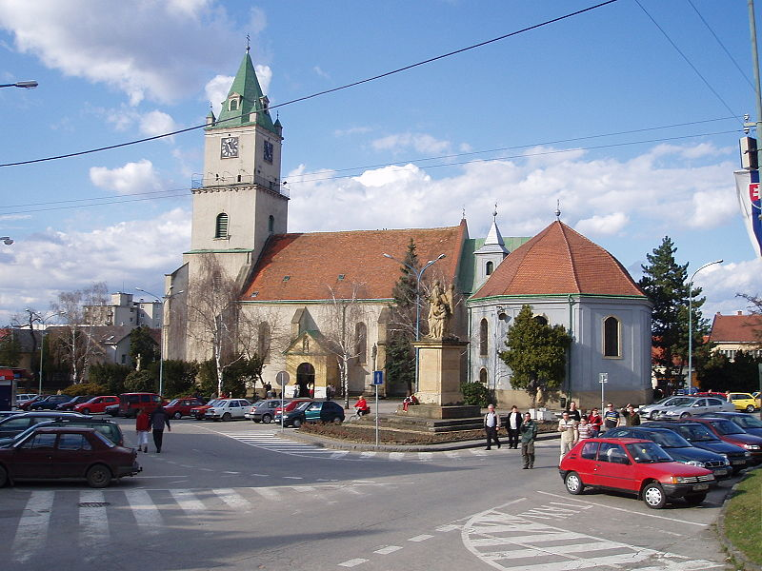
Hlohovec
OUR TOWN ☺
Matúš
Adam
Erik
Anton
Rachel
Karolína

Slide 3
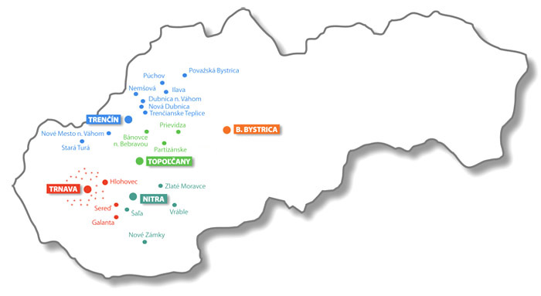
Hlohovec
is situated on the south west part of Slovakia
it is about 70 km from the capital city Bratislava
it is between Nitra, Trnava
and Topoľčany
about 23 000 people
live here

Slide 4
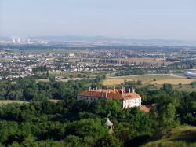
Hlohovec
is on the western part of the Carpatian Valley on the longest Slovak river the Váh
the first written evidence of its existence is from 1113 in Zobor Document

Slide 5
Hlohovec
The name of the town probably comes from the plant HLOH(whitethorn in English) which is widely spread in this area
It is confirmed with Hungarian name Galgócz( Hungarian galagonya – whitethron)
In the past it was also called Freistad from German

Slide 6
CASTLE GARDEN
Kristína
Natália
Alžbeta
Sára
Nina

Slide 7
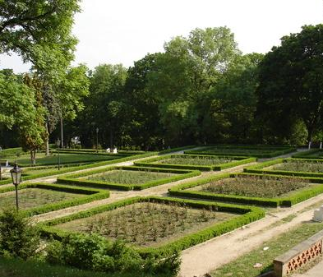
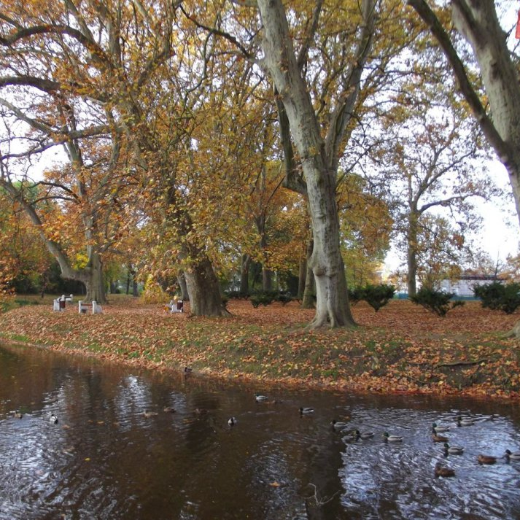
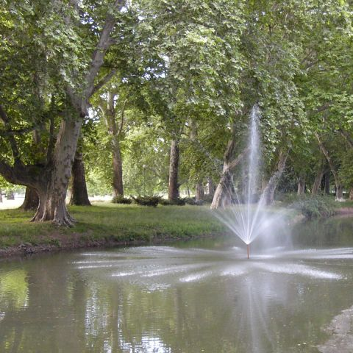
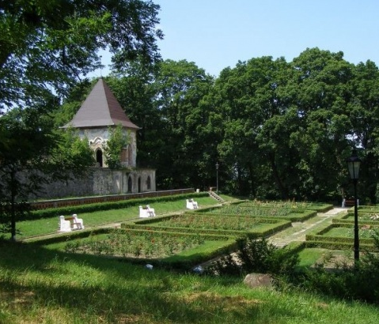
Castle garden
Is one of the largest planetree parks in Central Europe.
Several dozen plane trees grow here on approximately six hectares.
The oldest of them are over 200 years old.
You will also find the largest tree in the district of Hlohovec, which is approximately 40 meters high and its trunk circumference is about five and a half meters.

Slide 8
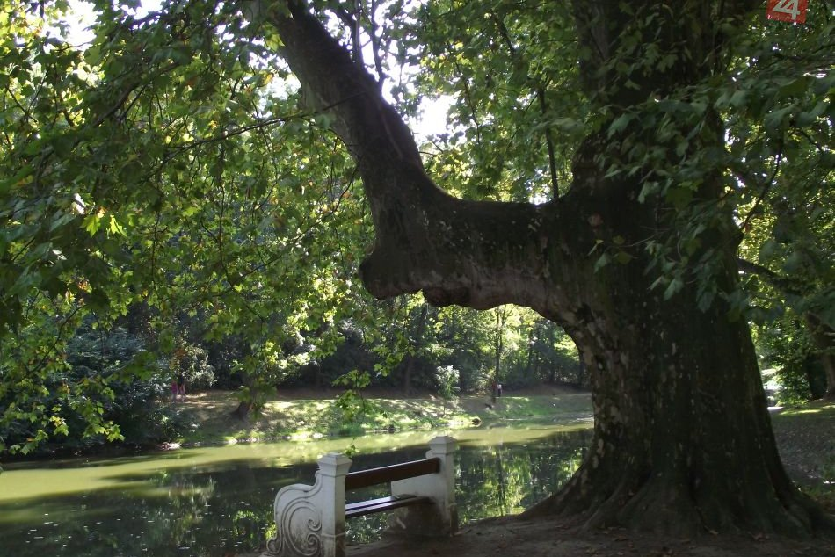
Legend
An interesting legend is attached to one of the plane trees, which is by the lake in the Castle Garden.
According to the legend, Jozef Erdődy, who had the park planted with his wife, could not have any children, and he had secret meeting here with his maid.
Apparently, when she became pregnant, his wife Elizabeth Mayer found out of this and had the maid expelled.
As the legend goes on, one of the branches, which until then constituted the heart symbol, broke off the plane tree, and since then the heart formed from the branches has been opened.

Slide 9
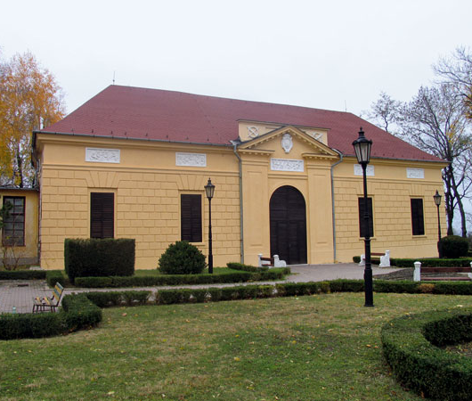
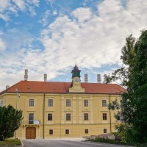
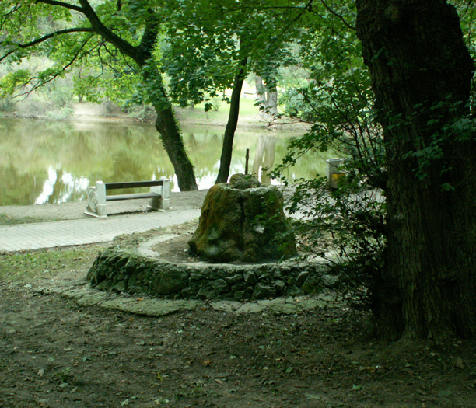
The wealth of the Castle Garden is not only hidden in nature.
We can find there more than a dozen of objects that are included in the list of National Cultural Monuments.
You can find here a castle, an Empire-style theatre, a riding school, a gardener's house, a glasshouse, a grotto with a relief.

Slide 10
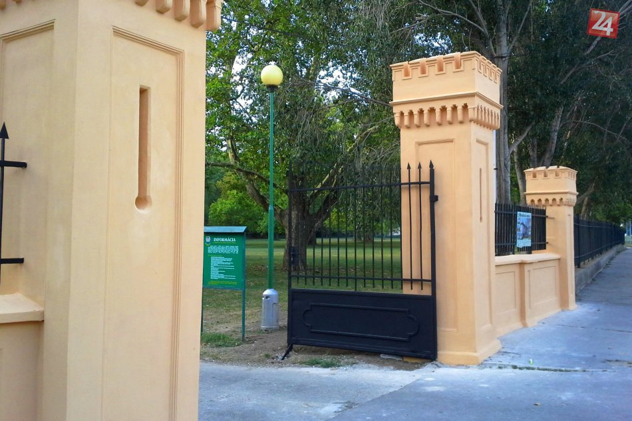
Attraction in the Castle Garden
A unique discovery was made near the former upper gate of the Castle Garden.
In the words of the director of the Homeland Museum in Hlohovec, a magnificently equipped old Hungarian grave from the 10th century was found here.
Shortly after its discovery, it was found in the collections of the National Museum in Budapest, where we can still admire them to this day.

Slide 11
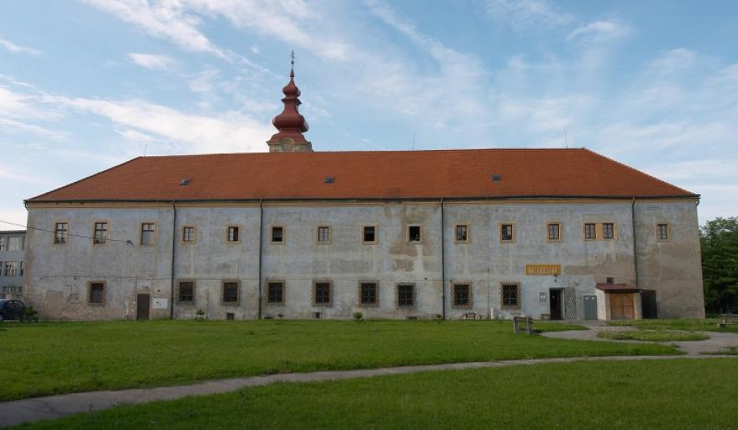
Museum in Hlohovec
Dominika
Ema
Lenka
Patrícia
Alžbeta
Nina

Slide 12
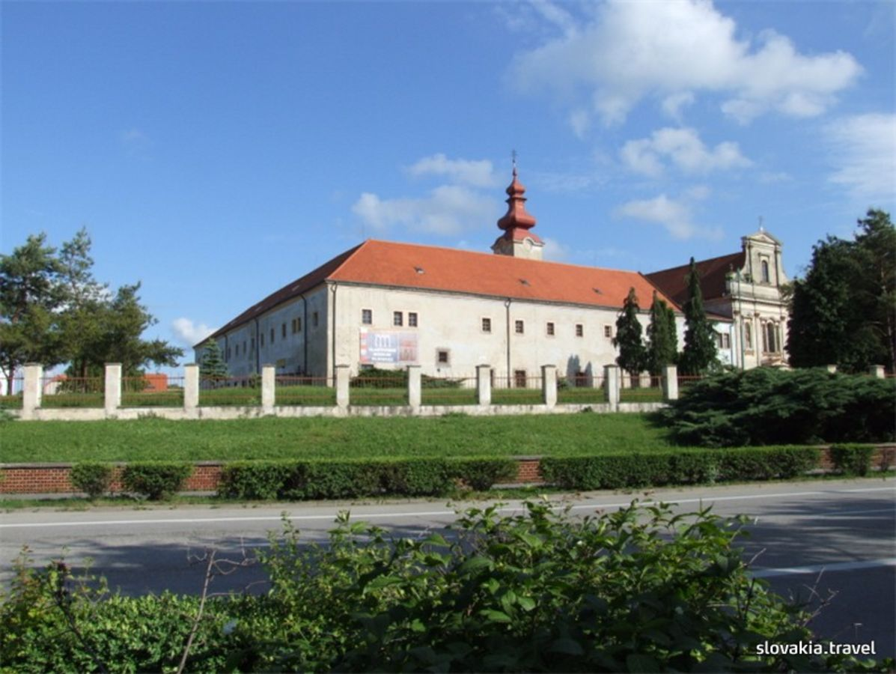
History of the museum
Homeland Museum in Hlohovec is located in the building of the Franciscan monastery on the Franciscan Square in Hlohovec.
The monastery was built in 1492 next to the ancient chapel of All Saints
Since 1959, after the reconstruction in the building was established Homeland Museum
After 1990, the Franciscans returned to a part of the monastery building

Slide 13
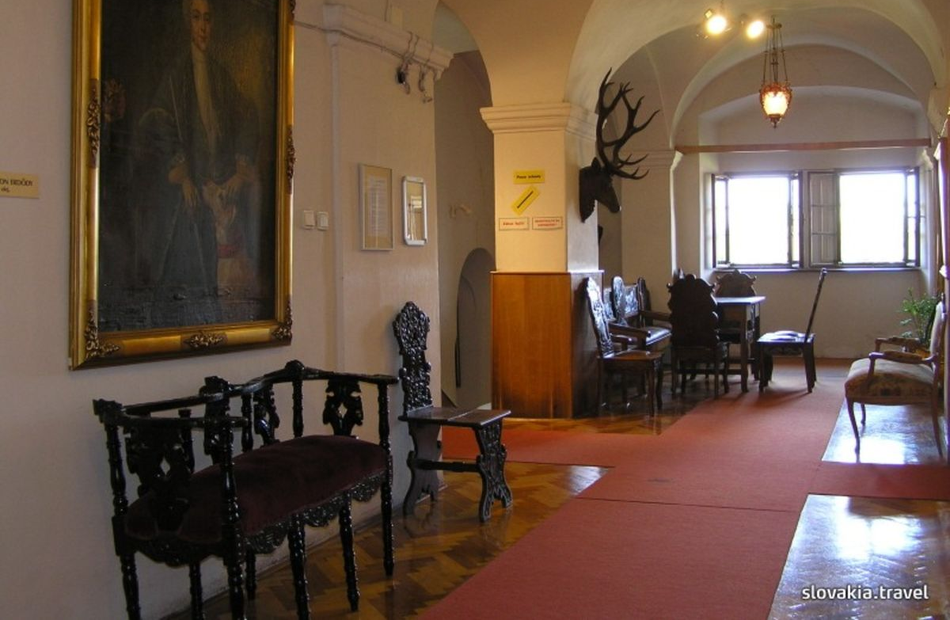
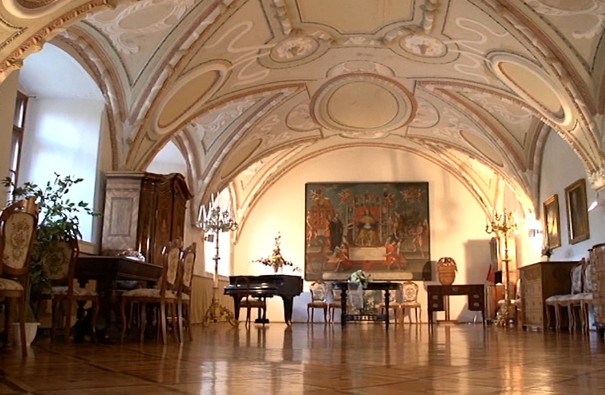
Museum
The museum belongs to typical regional museums of its character.
It manages collections of social and natural sciences.
It has an extensive collection of entomology and a valuable collection of regional history, ethnography and archeology.
It owns an interesting collection of mushroom models.

Slide 14
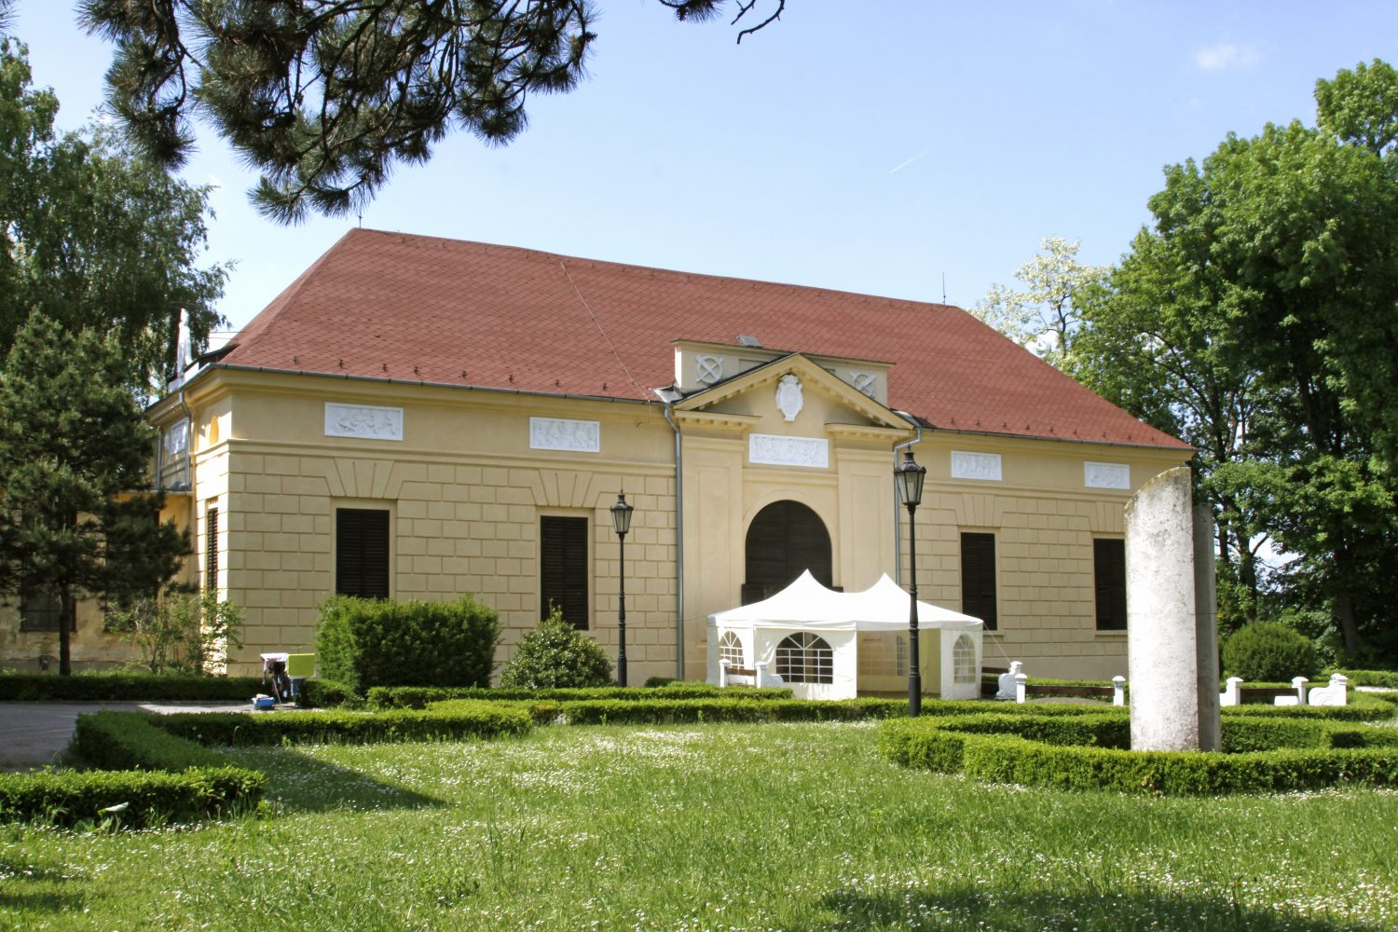
Empire Theatre
Lucia
Alžbeta
Martin S
Martin
Diana

Slide 15
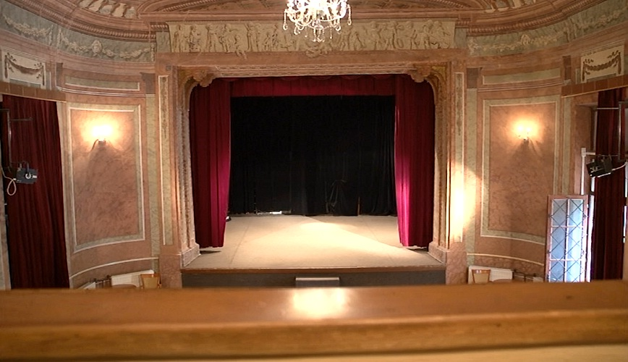
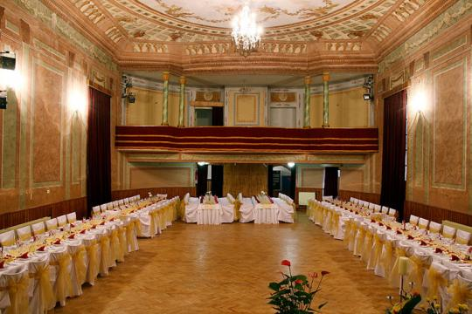
Interior of the building
In the building there are small rooms behind the
stage and a spiral-staircase leading to dressing
rooms on the first floor.
On the back wall of the balcony an original stone fire-place was preserved, today functionless.
The stage has trough-like vault. The hall is accessible by two entrances on the back side of the auditorium, the staircase leading to the balcony ends in the same hallway.
From the west, behind a glass door, there is a connecting corridor between the theatre and the former riding hall.

Slide 16
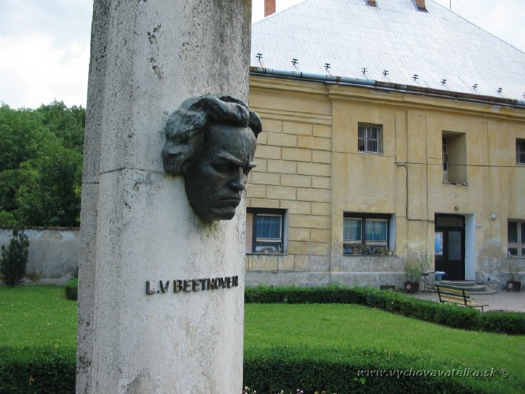
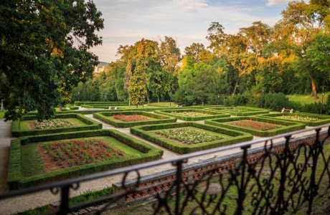
Outside of the Theatre
The garden was founded by Count Erdődy
Memorial commemorating the visit of the worldfamous musical composer Ludwig van Beethoven in Hlohovec. During his stay in Pieštany, he visited Hlohovec mansion of then owner‘s castle, Joseph Erdődy, that gave order to build it.
Beethoven has just had performance as a well-known artist.
By the end of World War I, Empire Theatre also kept the piano on which Beethoven allegedly played and also a memorable book with his signature.
The monument with the composer‘s head is in front of the Empire Theatre building.
On the flower terraces of the park we can find 100 years old yew stands with red poisonous fruits

Slide 17
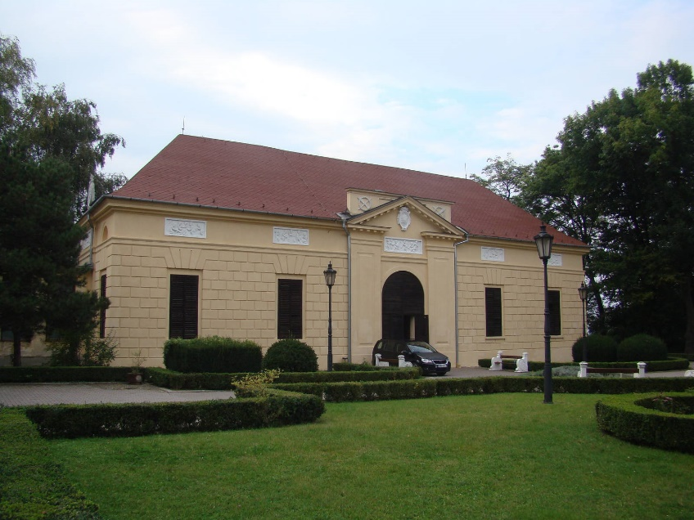
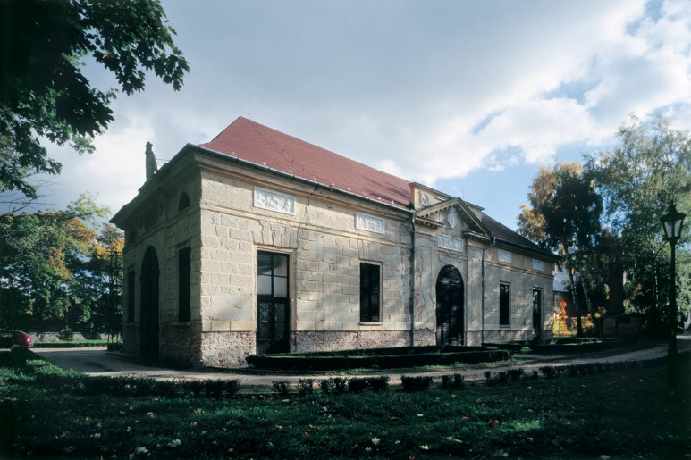
Origin of the Empire Theatre
Theatre in Hlohovec, was built in 1801-1802 for Joseph Erdödy
The Hlohovec Theatre belongs to the group of small private theatres
Hlohovec Theatre is the only example of a theatre of it‘s kind in Slovakia
These theatres were used for private entertainment

Slide 18
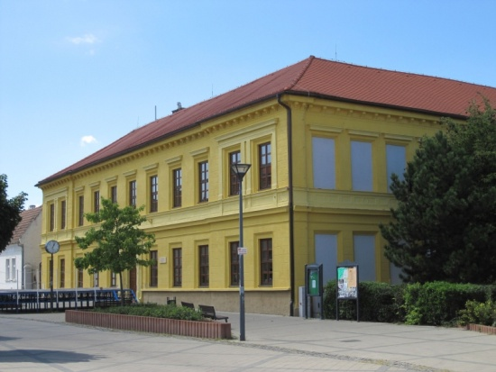
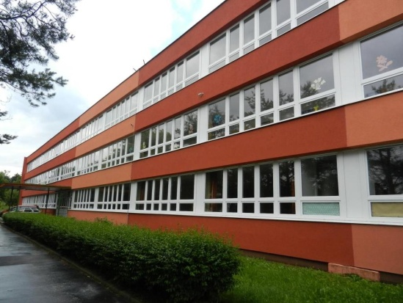
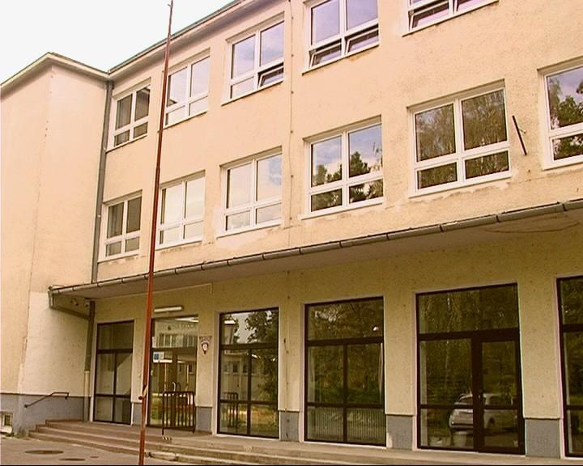
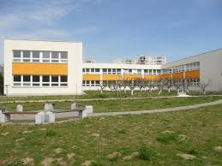
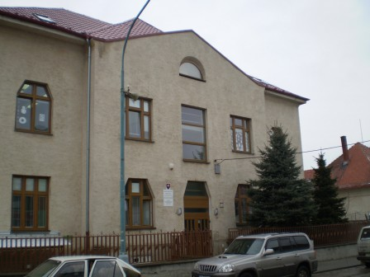
Schools in Hlohovec
There are four Primary Schools
There is one Special Primary School

Slide 19
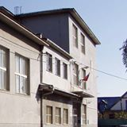
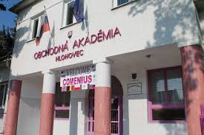
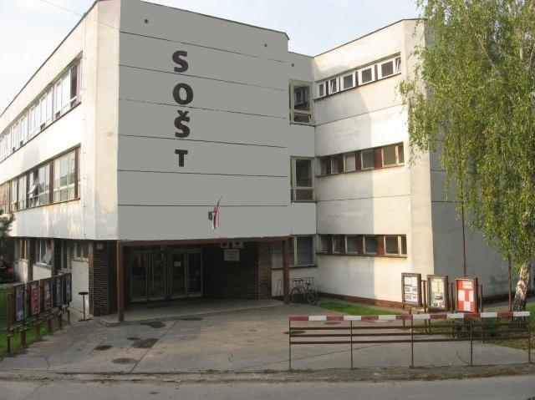
Schools in Hlohovec
There are three Secondary Schools
Grammar School Bussiness Academy Vocational School

Slide 20
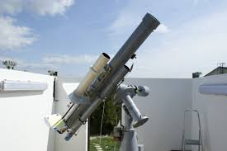
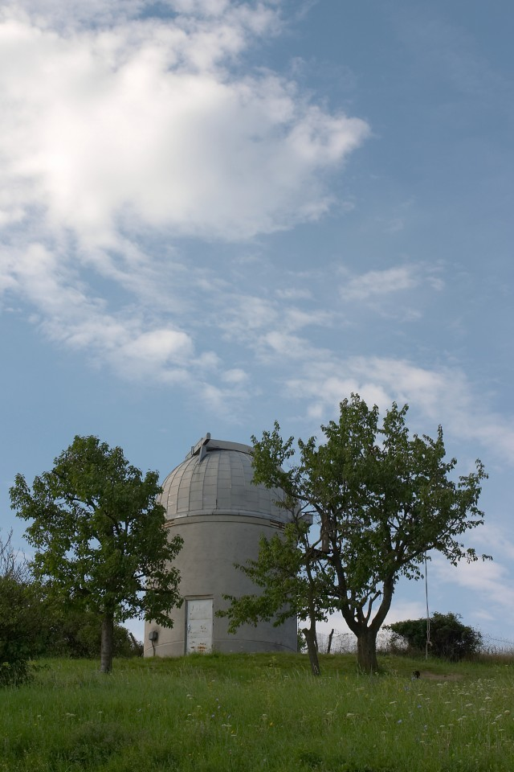
Observatory and Planetarium
The observatory is located in the south-west part of the town of Hlohovec.
It is just about 15 minutes on foot from the town square.
The observatory itself is situated on the top of the hill called Svinna hora ("Swine hill").
Hlohovec is one of the nineteen towns in Slovakia with an observatory and one of the five towns in Slovakia with a planetarium.

Slide 21
That was our town. Thank you.
☺

Slide 22
Sources:
http://www.pardontt.sk/pokrytie
http://eng.hlohovec.sk/hlohovec.phtml?id3=46888
https://sk.wikipedia.org/wiki/Hlohovec
http://www.hvezdaren.org/index.php?option=com_content&view=article&id=31&Itemid=23
http://obcan.hlohovec.sk/zakladne-skoly.phtml?id3=65641
https://www.theatre-architecture.eu/en/db/?theatreId=215 https://profil.kultury.sk/en/empire-theatre-in-hlohovec/ http://www.bobinsvet.eu/zaujmove_cinnosti/sporotvobranna/geocaching/12_hlohovsky%20zamok.htm http://regionhlohovec.sk/clanok-64_3-580/Zamocka_zahrada.html%C5%88 https://www.google.com/url?sa=i&source=images&cd=&cad=rja&uact=8&ved=2ahUKEwjeycyKvrXlAhWFEVAKHR9KAMIQjB16BAgBEAM&url=http%3A%2F%2Feng.hlohovec.sk%2Fmonuments.phtml%3Fid3%3D96549&psig=AOvVaw1XR1gfqdZBYZOIQkO3tM3T&ust=1572022593416490 https://www.google.com/url?sa=i&source=images&cd=&cad=rja&uact=8&ved=2ahUKEwiXiYCivrXlAhUBJFAKHXENDMsQjB16BAgBEAM&url=http%3A%2F%2Feng.hlohovec.sk%2Fmonuments.phtml%3Fid3%3D96549&psig=AOvVaw1XR1gfqdZBYZOIQkO3tM3T&ust=1572022593416490
https://hlohovec.dnes24.sk/o-tomto-ste-vedeli-10-naj-zaujimavosti-o-zamockej-zahrade-270053
http://mesto.hlohovec.sk/zamocky-park.phtml?id3=66343
https://hlohovec.dnes24.sk/galeria/fotogaleria-zamocka-zahrada-hra-jesennymi-farbami-62854/fotografia-36?articleId=254292
https://sk.wikipedia.org/wiki/Vlastivedn%C3%A9_m%C3%BAzeum_v_Hlohovci
http://muzeumhlohovec.sk/kontakt/
http://slovakia.travel/vlastivedne-muzeum-v-hlohovci
http://www.hcregion.sk/hcregion.php?lng=sk&docid=201&adr=_vm

